Slide 1
Operations of Basic Signals
IT3105: Signals and systems

Slide 2
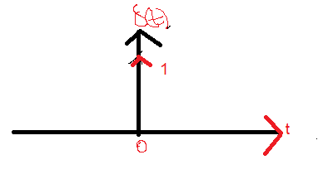
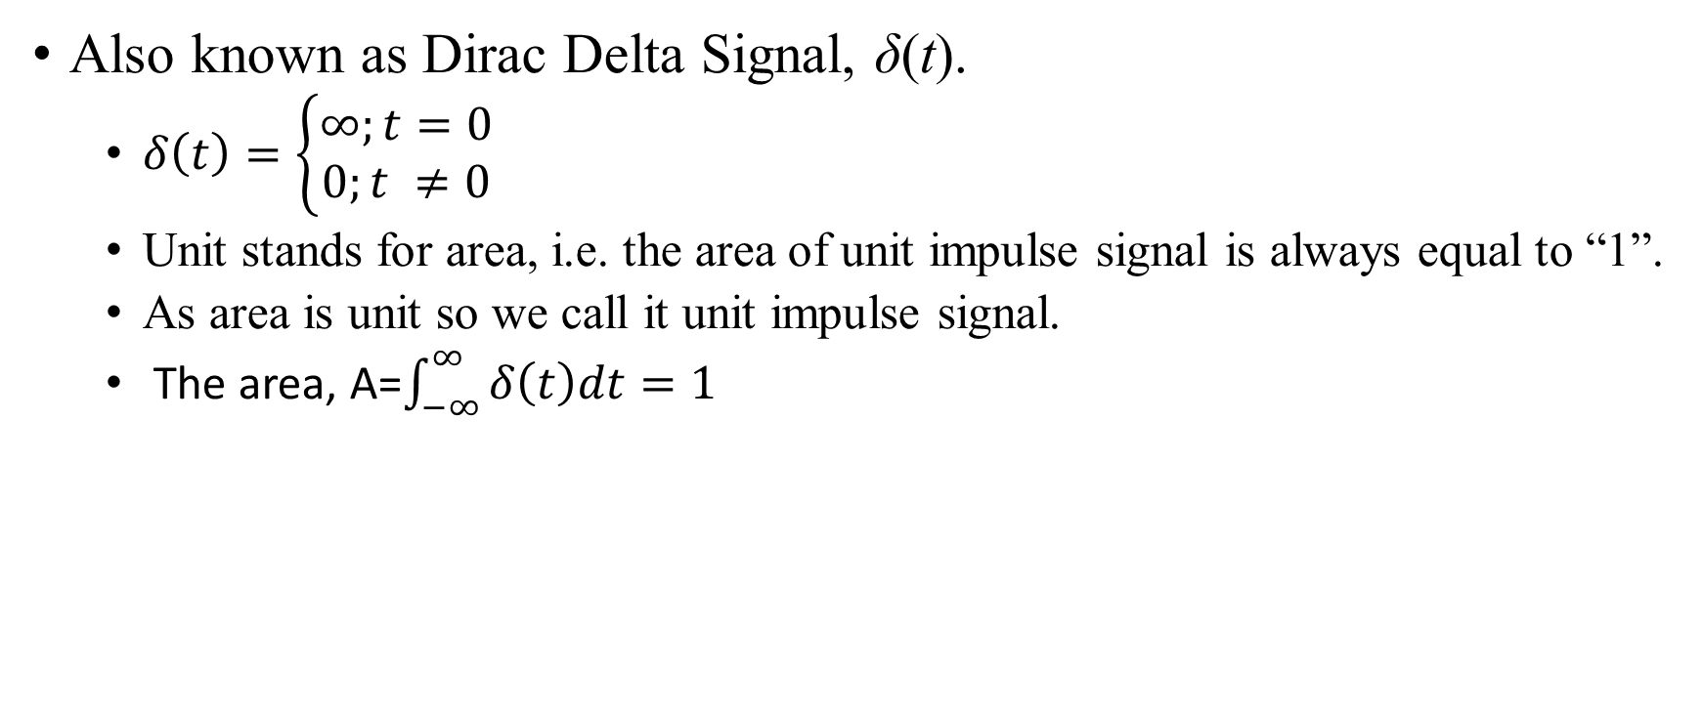
Unit Impulse Signal
Also known as Dirac Delta Signal, δ(t).
$δ\left(t\right)=\left\{\begin{aligned}∞;t=0 \\ 0;t ≠0\end{aligned}\right.$
Unit stands for area, i.e. the area of unit impulse signal is always equal to “1”.
As area is unit so we call it unit impulse signal.
The area, A=$\int_{−∞}^{∞}{δ\left(t\right)dt=1}$

Slide 3
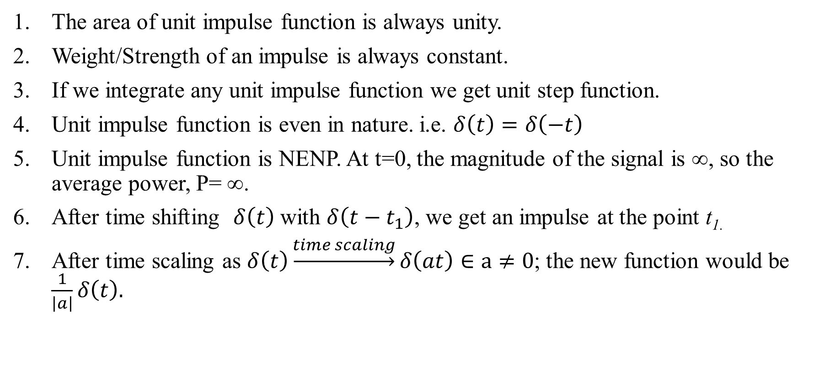
Properties of Unit Impulse Function
The area of unit impulse function is always unity.
Weight/Strength of an impulse is always constant.
If we integrate any unit impulse function we get unit step function.
Unit impulse function is even in nature. i.e. $δ\left(t\right)=δ\left(−t\right)$
Unit impulse function is NENP. At t=0, the magnitude of the signal is ∞, so the average power, P= ∞.
After time shifting $δ\left(t\right)$ with $δ\left(t−t_{1}\right)$, we get an impulse at the point t_{1.}
After time scaling as $δ\left(t\right)\underset{→}{time scaling}δ\left(at\right)∈a≠0$; the new function would be $\frac{1}{\left|a\right|}δ\left(t\right).$

Slide 4
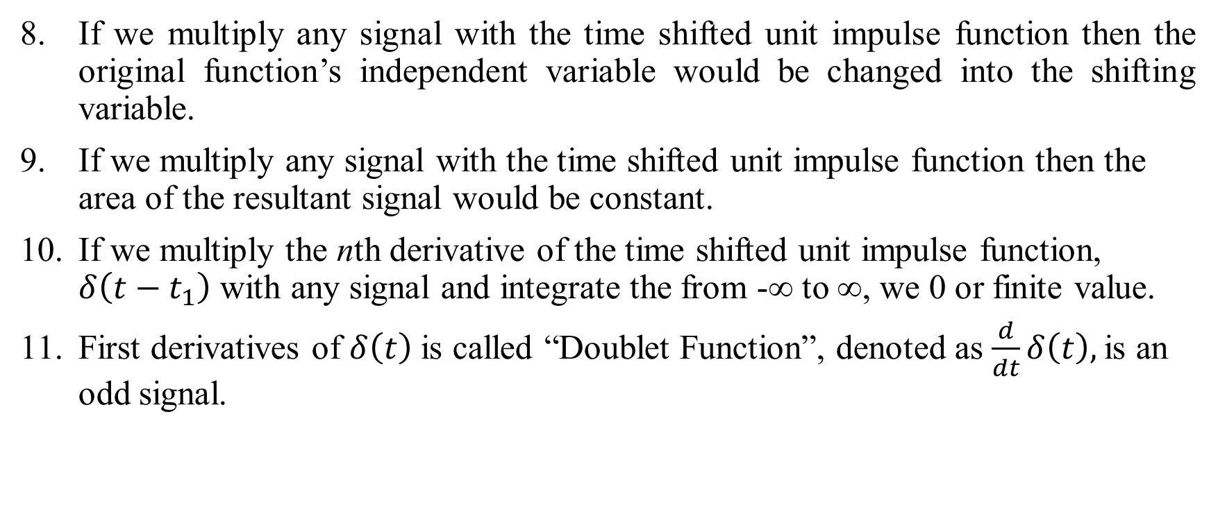
Properties of Unit Impulse Function
If we multiply any signal with the time shifted unit impulse function then the original function’s independent variable would be changed into the shifting variable.
If we multiply any signal with the time shifted unit impulse function then the area of the resultant signal would be constant.
If we multiply the nth derivative of the time shifted unit impulse function, $δ\left(t−t_{1}\right)$ with any signal and integrate the from -∞ to ∞, we 0 or finite value.
First derivatives of $δ\left(t\right)$ is called “Doublet Function”, denoted as $\frac{d}{dt}δ\left(t\right),$is an odd signal.

Slide 5
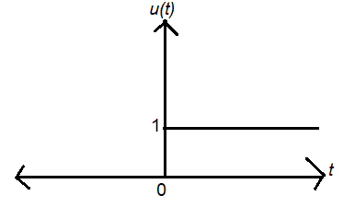
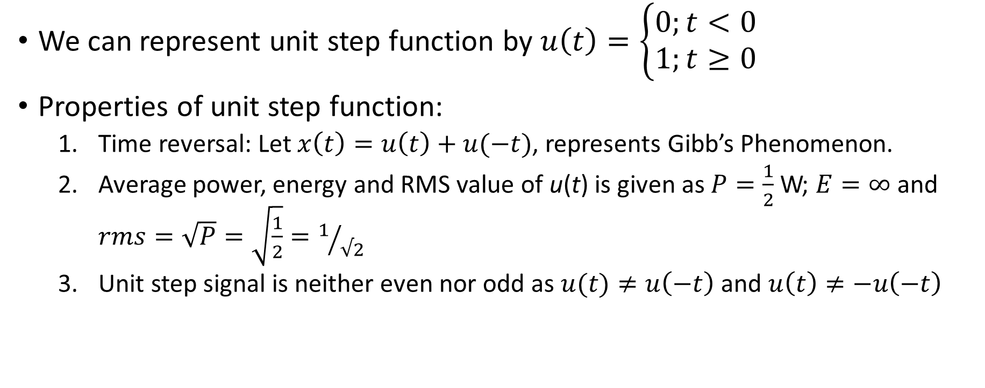
Unit Step Function
We can represent unit step function by $u\left(t\right)=\left\{\begin{aligned}0;t<0 \\ 1;t≥0\end{aligned}\right.$
Properties of unit step function:
Time reversal: Let $x\left(t\right)=u\left(t\right)+u(−t)$, represents Gibb’s Phenomenon.
Average power, energy and RMS value of u(t) is given as $P=\frac{1}{2}$ W; $E=∞$ and $rms=\sqrt{P}=\sqrt{\frac{1}{2}}=1/{√2}$
Unit step signal is neither even nor odd as $u(t)≠u\left(−t\right)$ and $u\left(t\right)≠−u\left(−t\right)$

Slide 6
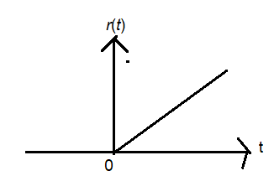
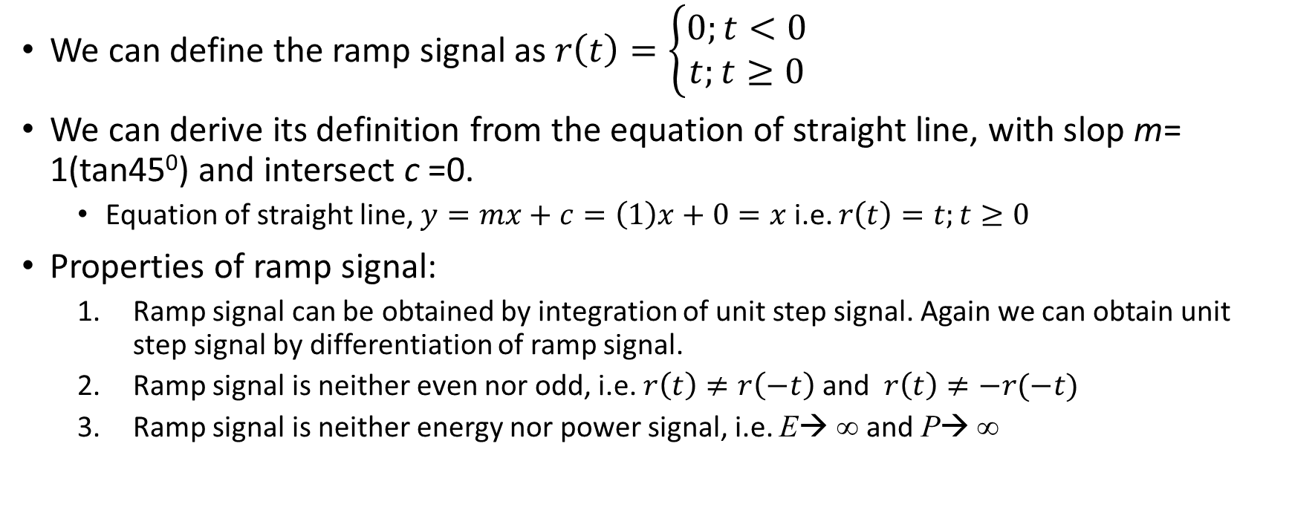
Unit Ramp Signal
We can define the ramp signal as $r\left(t\right)=\left\{\begin{aligned}0;t<0 \\ t;t≥0\end{aligned}\right.$
We can derive its definition from the equation of straight line, with slop m= 1(tan45⁰) and intersect c =0.
Equation of straight line, $y=mx+c=\left(1\right)x+0=x$ i.e. $r\left(t\right)=t;t≥0$
Properties of ramp signal:
Ramp signal can be obtained by integration of unit step signal. Again we can obtain unit step signal by differentiation of ramp signal.
Ramp signal is neither even nor odd, i.e. $r\left(t\right)≠r\left(−t\right)$ and $r\left(t\right)≠−r(−t)$
Ramp signal is neither energy nor power signal, i.e. E→ ∞ and P→ ∞

Slide 7
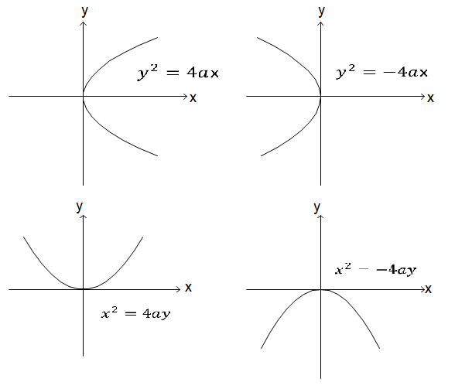
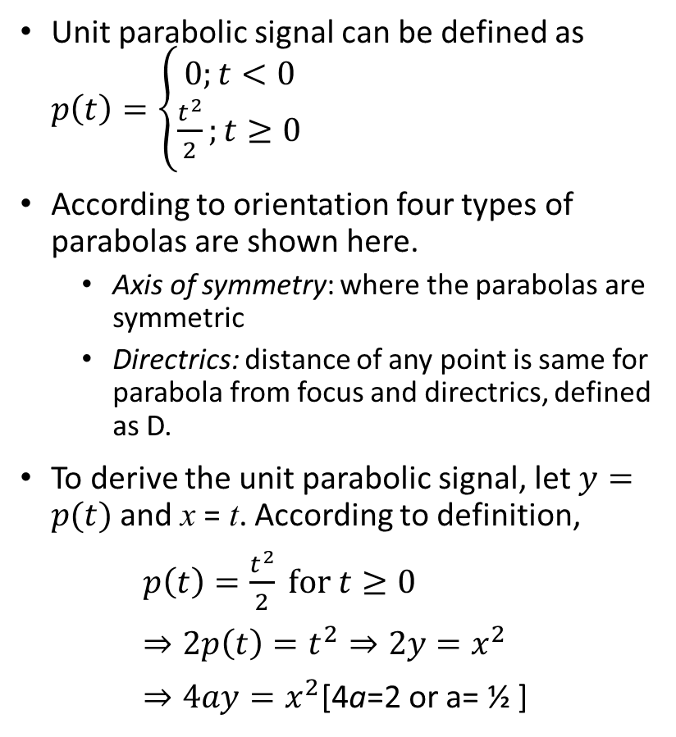
Unit Parabolic Signal
Unit parabolic signal can be defined as $p\left(t\right)=\left\{\begin{aligned}0;t<0 \\ \frac{t^{2}}{2};t≥0\end{aligned}\right.$
According to orientation four types of parabolas are shown here.
Axis of symmetry: where the parabolas are symmetric
Directrics: distance of any point is same for parabola from focus and directrics, defined as D.
To derive the unit parabolic signal, let $y=p(t)$ and x = t. According to definition,
$p\left(t\right)=\frac{t^{2}}{2} for t≥0$
$⇒2p\left(t\right)=t^{2}⇒2y=x^{2}$
$⇒4ay=x^{2}$[4a=2 or a= ½ ]
(b)
(a)
(c)
(d)

Slide 8
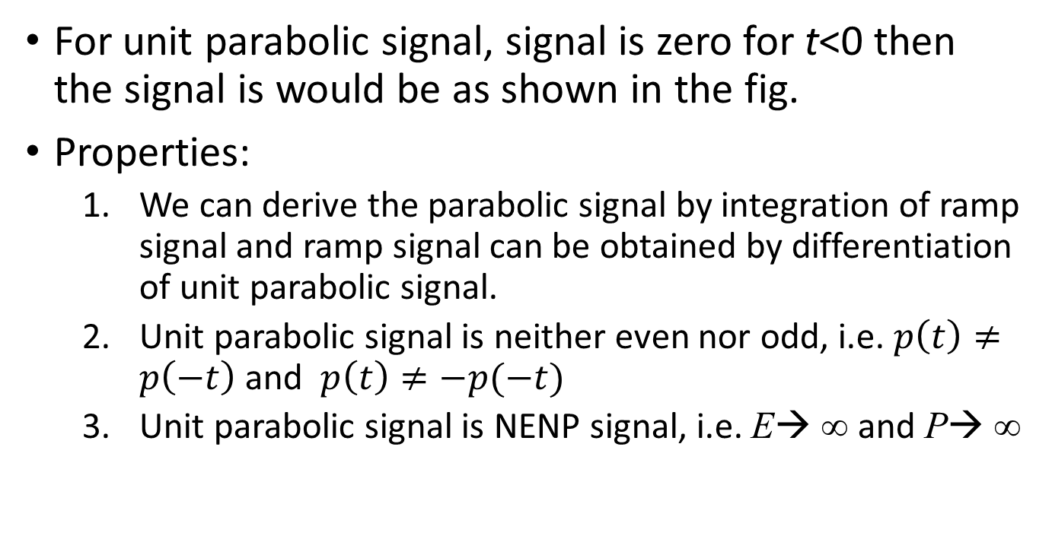
Unit Parabolic Signal
For unit parabolic signal, signal is zero for t<0 then the signal is would be as shown in the fig.
Properties:
We can derive the parabolic signal by integration of ramp signal and ramp signal can be obtained by differentiation of unit parabolic signal.
Unit parabolic signal is neither even nor odd, i.e. $p\left(t\right)≠p\left(−t\right)$ and $p\left(t\right)≠−p(−t)$
Unit parabolic signal is NENP signal, i.e. E→ ∞ and P→ ∞

Slide 9
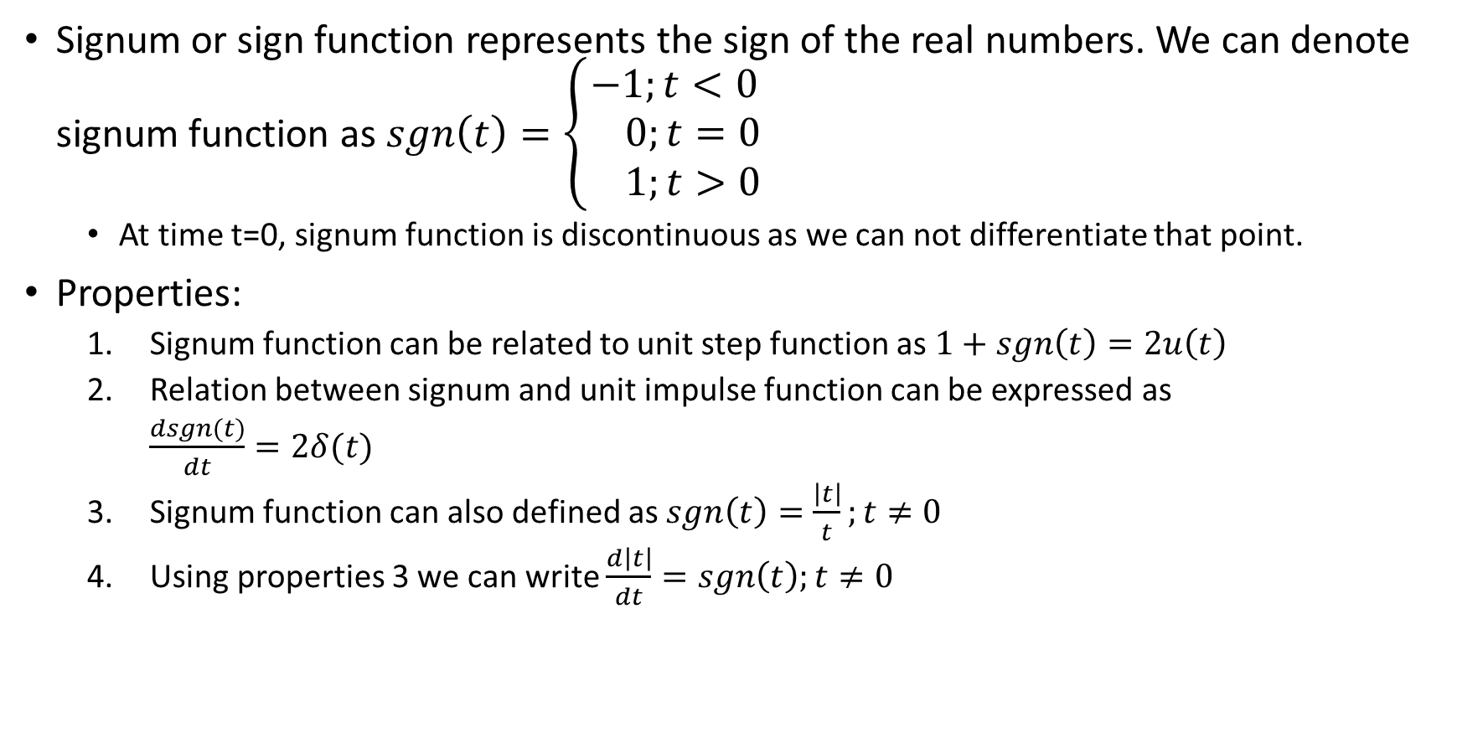
Signum Function
Signum or sign function represents the sign of the real numbers. We can denote signum function as $sgn\left(t\right)=\left\{\begin{aligned}−1;t<0 \\ 0;t=0 \\ 1;t>0\end{aligned}\right.$
At time t=0, signum function is discontinuous as we can not differentiate that point.
Properties:
Signum function can be related to unit step function as $1+sgn\left(t\right)=2u\left(t\right)$
Relation between signum and unit impulse function can be expressed as
$\frac{dsgn(t)}{dt}=2δ(t)$
Signum function can also defined as $sgn\left(t\right)=\frac{\left|t\right|}{t};t≠0$
Using properties 3 we can write $\frac{d\left|t\right|}{dt}=sgn\left(t\right);t≠0$

Slide 10
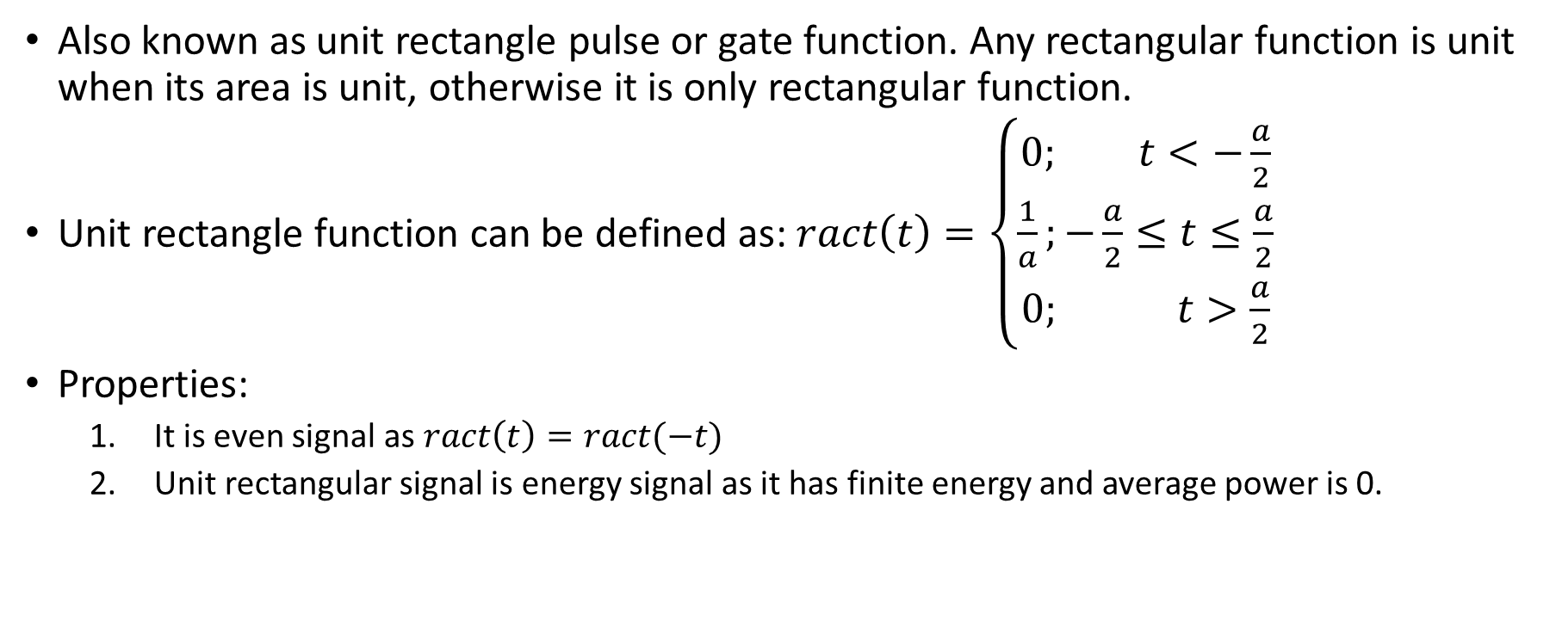
Unit rectangle function
Also known as unit rectangle pulse or gate function. Any rectangular function is unit when its area is unit, otherwise it is only rectangular function.
Unit rectangle function can be defined as: $ract\left(t\right)=\left\{\begin{aligned}0; t<−\frac{a}{2} \\ \frac{1}{a};−\frac{a}{2}≤t≤\frac{a}{2} \\ 0; t>\frac{a}{2}\end{aligned}\right.$
Properties:
It is even signal as $ract\left(t\right)=ract(−t)$
Unit rectangular signal is energy signal as it has finite energy and average power is 0.

Slide 11

Unit Triangular Function
When any triangular function has unit area then it is called unit triangular function defined as $tri\left(t\right)=\left\{\begin{aligned}t+1; −1≤t≤0 \\ −t+1; 0≤t≤1\end{aligned}\right.$
Properties:
It is even signal as $tri\left(t\right)=tri(−t)$
Its an energy signal.

Slide 12
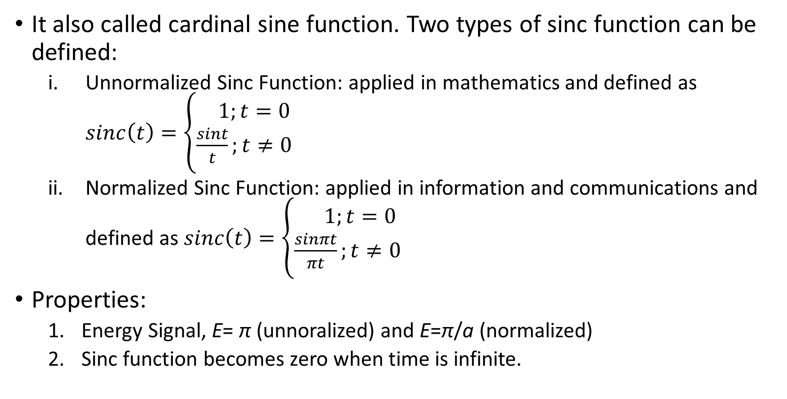
Sinc Function
It also called cardinal sine function. Two types of sinc function can be defined:
Unnormalized Sinc Function: applied in mathematics and defined as $sinc\left(t\right)=\left\{\begin{aligned} 1;t=0 \\ \frac{sint}{t};t≠0\end{aligned}\right.$
Normalized Sinc Function: applied in information and communications and defined as $sinc\left(t\right)=\left\{\begin{aligned} 1;t=0 \\ \frac{sinπt}{πt};t≠0\end{aligned}\right.$
Properties:
Energy Signal, E= π (unnoralized) and E=π/a (normalized)
Sinc function becomes zero when time is infinite.

Slide 13
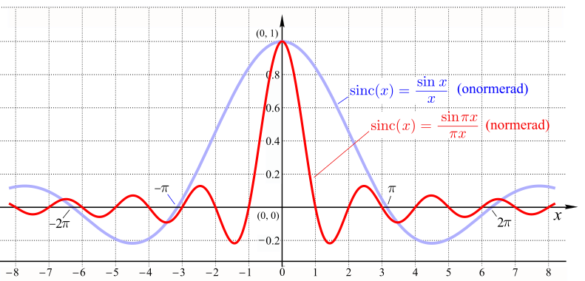
Sinc Function
https://commons.wikimedia.org/wiki/File:Sinc-function.png

Slide 14
Thank You!

